Slide 1
Amazon Elastic Compute Cloud (EC2)

Slide 2
Amazon Elastic Compute Cloud (EC2) is a part of Amazon.com's cloud- computing platform, Amazon Web Services (AWS), that allows users to rent virtual computers on which to run their own computer applications. EC2 encourages scalable deployment of applications by providing a web service through which a user can boot an Amazon Machine Image (AMI) to configure a virtual machine, which Amazon calls an "instance", containing any software desired.

Slide 3
Amazon Elastic Compute Cloud (EC2) is offered as a web service that provides resizable compute capacity in the cloud. With EC2, you can set up and configure virtual machines,known as "instances", which are run on top of Amazon's physical servers. These instances can be customized to meet your specific needs, such as by choosing the operating system, CPU,memory, and storage that you want. You can also choose the number of instances to launch, and the geographical region in which you want your instances to be located.

Slide 4
EC2 makes it easy to scale your computing resources up or down, depending on your needs
You can increase the number of instances you are using to handle a sudden increase in traffic, and then scale back down when the traffic subsides.
This can help you save money on your computing costs, as you only pay for the resources that you actually use.

Slide 5
Advantages of using EC2 over your own computers
Flexibility
Scalability
Cost efficiency
Reliability
Security

Slide 6
EC2 is a central part of the cloud computing model, as it provides the infrastructure that allows users to access computing resources over the internet. With EC2, users can easily set up and configure virtual machines, choose the resources they need, and scale their computing resources as needed. This makes it possible for users to take advantage of the benefits of cloud computing, such as reduced costs, increased flexibility, and improved scalability.

Slide 7
Use Cases of EC2
Web and application hosting
Big data processing
Gaming
Media processing
Scientific simulations
Business applications

Slide 8
EC2 Architecture
Physical infrastructure
Virtualization layer
EC2 service layer
Application layer

Slide 9
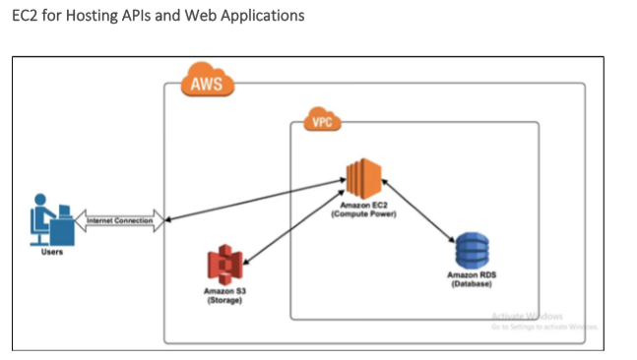
VPC-Virtual private cloud

Slide 10
how you can use Amazon EC2 to build APIs
Set up an EC2 instance
Install necessary software
Develop your API
Deploy your API
Test and debug your API
Monitor and scale your API
Set up an EC2 instance

Slide 11
Amazon Simple Storage Service (S3) is a web service that provides object storage through a network of servers
Amazon EC2 (Elastic Compute Cloud) is a web service that provides resizable compute capacity in the cloud

Slide 12
EC2 and S3 can be used together in the following ways:
Storing data
Backing up data
Running applications
Transferring data
Overall, S3 and EC2 can be used together to provide a secure and scalable storage and computing solution in the cloud.

Slide 13
Amazon Relational Database Service (RDS) is a web service that makes it easy to set up, operate, and scale a relational database in the cloud
Amazon EC2 (Elastic Compute Cloud) is a web service that provides resizable compute capacity in the cloud.

Slide 14
EC2 and RDS can be used together in the following ways:
Hosting a database
Running database-backed applications
Scaling resources
Overall, EC2 and RDS can be used together to provide a scalable and reliable platform for running database-backed applications in the cloud.

